Slide 1


A
PROJECT PRESENTATION
ON
Pneumonia Detection
Using Convolution Neural Networks

Slide 2
Project Team
Dr. David Ruby
Professor, Department of Science
and Mathematics
Vasu Patel
Harika Yendapalli
Tanay Malavia

Slide 3
Problem Statement
To Design and Implement Pneumonia Detection using Convolution Neural Networks

Slide 4
Objectives
Develop a deep learning-based system for the accurate classification of chest X-ray images into NORMAL and PNEUMONIA categories.
Minimize human error and variability in chest X-ray interpretation by leveraging CNNs to achieve consistent and reliable results.
Implement effective preprocessing, augmentation, and class balancing techniques to improve model robustness and prevent overfitting.
Provide a scalable, accessible, and transparent diagnostic tool to assist healthcare professionals in improving patient outcomes and reducing diagnostic delays.

Slide 5
Work Plan
Collection of data set from various sources
Implementation of the deep learning models
Training the model with training data set
Testing model’s accuracy using testing data set

Slide 6
System Overview
Proposed System -
1
2
3
4
Chest X-ray images
Preprocessing
Development
Classification
Fig. 2

Slide 7
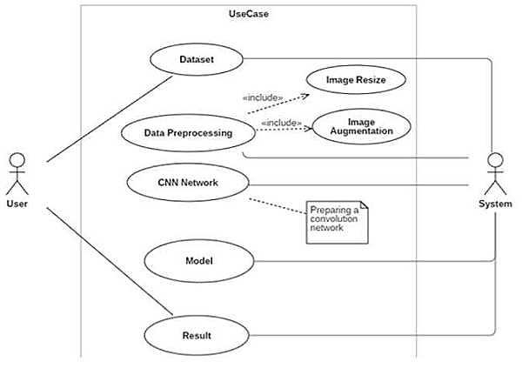
Use Case Diagram

Slide 8
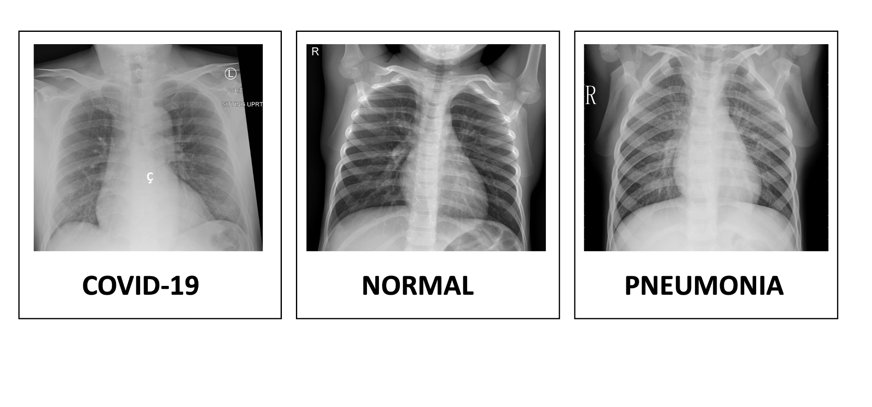
Normal
Pneumonia

Slide 9
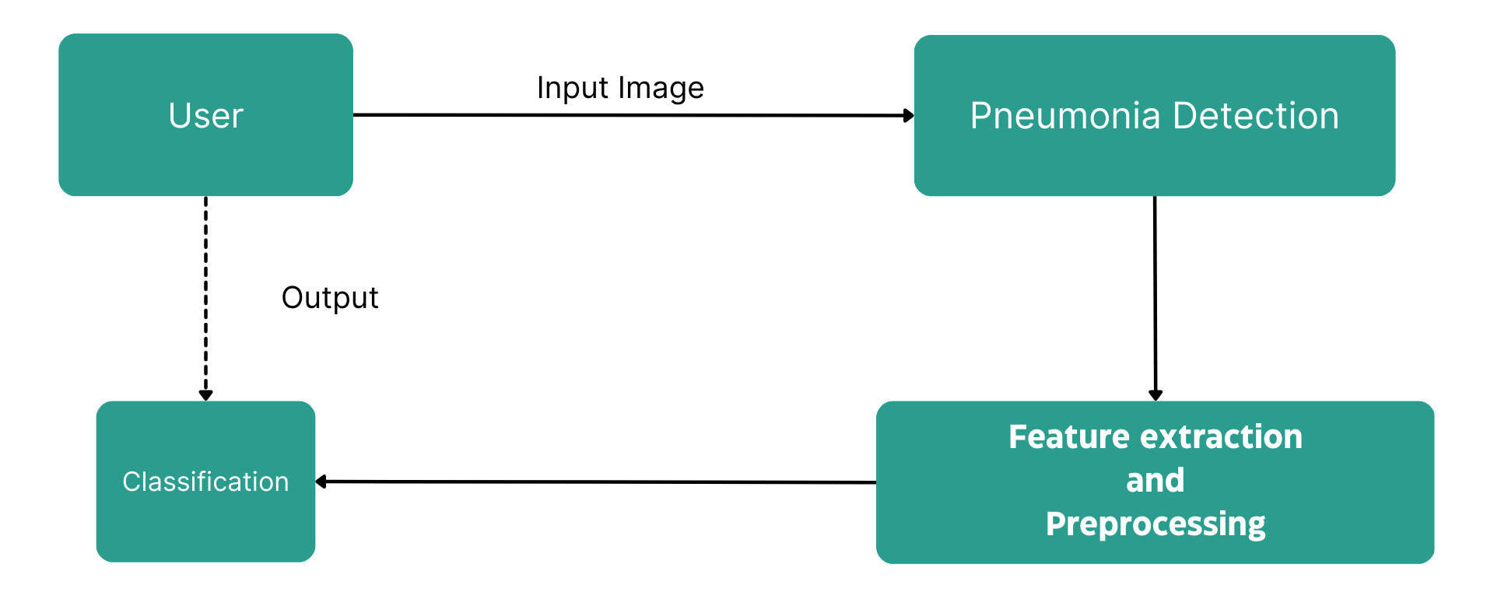
Level 1 Data Flow Diagram

Slide 10
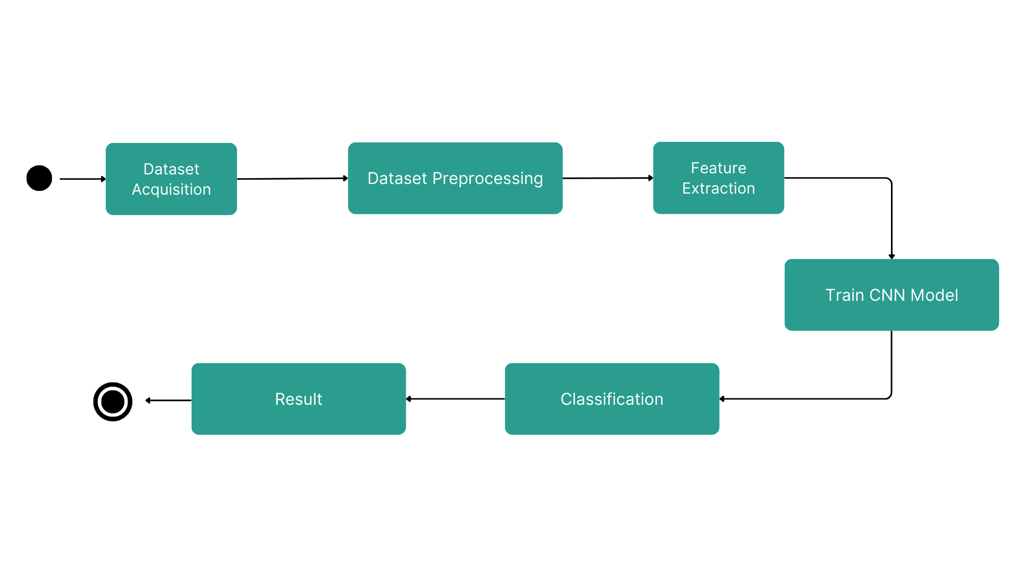
State Diagram

Slide 11
Algorithms & Techniques
Keras:
Keras is an Open Source Neural Network library written in Python that runs on top of Tensorflow. It is designed to be modular, fast and easy to use. Keras High-Level API handles the way we make models, defining layers, or set up multiple input-output models.
Tensor Flow:
It is an open source artificial intelligence library, using data flow graphs to build models. It allows developers to create large-scale neural networks with many layers. TensorFlow is mainly used for: Classification, Perception, Understanding, Discovering, Prediction and Creation.

Slide 12
What is kaggle?
Kaggle, a subsidiary of Google LLC, is an online community of data scientists and machine learning practitioners. Kaggle allows users to find and publish data sets, explore and build models in a web-based data-science environment, work with other data scientists and machine learning engineers, and enter competitions to solve data science challenges.
Our Dataset
Kermany, Daniel; Zhang, Kang; Goldbaum, Michael(2018), "Labeled Optical Coherence Tomography(OCT) and Chest X-Ray Images For Classification", Mendeley Data, v2
https://www.kaggle.com/code/paultimothymooney/detecting-pneumonia-in-x-ray-images/input

Slide 13
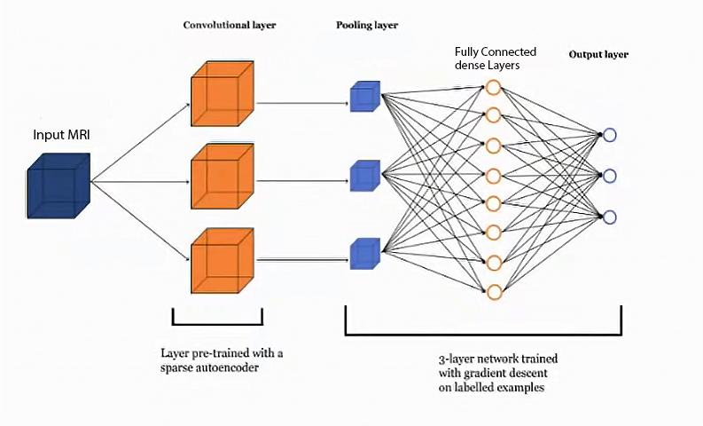
CNN Architecture

Slide 14
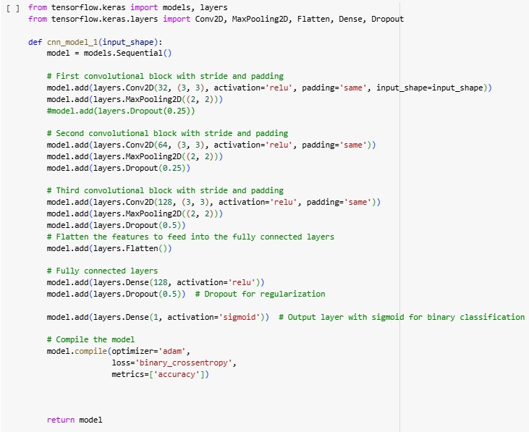
CNN Model

Slide 15
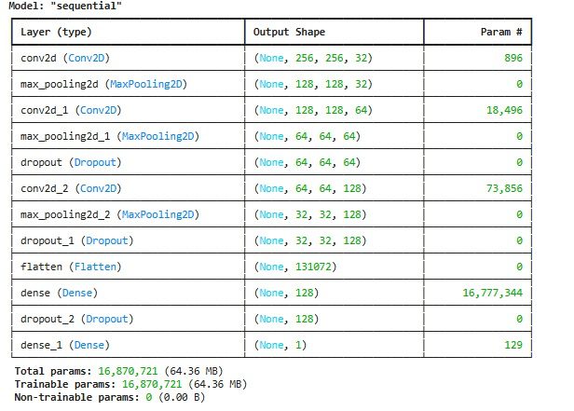

Slide 16
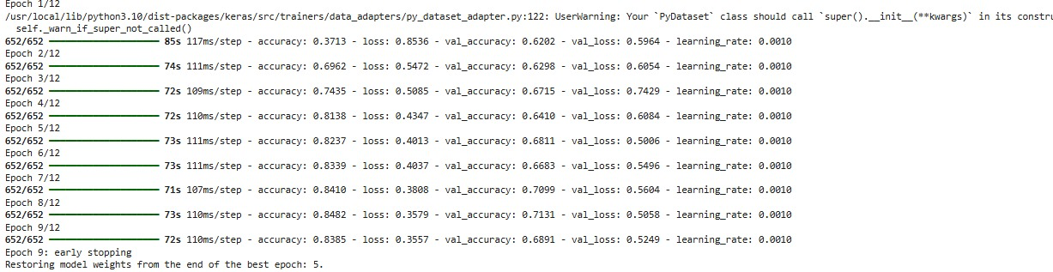
CNN Model Accuracy

Slide 17
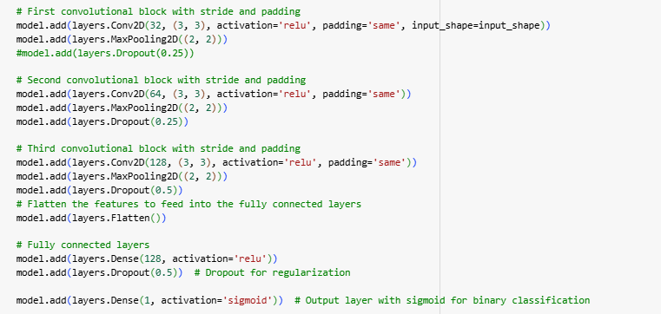
CNN model sequence algorithm :
layer 1 conv
layer 1 pool
Layer 2 conv
layer 2 pool
layer 3 conv
layer 3 pool
Dense
Layers/
ANN layers
17

Slide 18
Dataset Preprocessing (Defining some of the Image Data Generator parameters)
rescale —higher pixel range image results in greater loss and a lower learning rate should be used, lower pixel range image would require a higher learning rate.
shear_range — The shape of the image is the transformation of the shear. It fixes one axis and stretches the image at a certain angle known as the angle of the shear.
zoom_range — The image is enlarged by a zoom of less than 1.0. The image is more than 1.0 zoomed out of the picture.
horizontal_flip —Some images are flipped horizontally at random
vertical_flip — Some images are flipped vertically at random
roataion_range — Randomly, the image is rotated by some degree in the range 0 to 180.
width_shift_range — Shifts the image horizontally.
height_shift_range — Shifts the image vertically.
brightness_range — brightness of 0.0 corresponds to absolutely no brightness, and 1.0
corresponds to maximum brightness
fill_mode — Fills the missing value of the image to the nearest value or to the wrapped value
or to the reflecting value.

Slide 19
CNN
Convolutional Neural Networks (CNNs) are a specialized type of neural network designed to process and classify images. In the provided model, convolutional layers with 3x3 filters are used to extract essential features like edges and textures, while ReLU activation functions introduce non-linearity by mapping negative values to zero. MaxPooling layers with a 2x2 window reduce the dimensionality of feature maps, preserving critical information while minimizing computational complexity. The final fully connected layers process these features for classification, with a Sigmoid activation function in the output layer mapping predictions to probabilities between 0 and 1 for binary classification (NORMAL vs. PNEUMONIA). The model employs binary cross-entropy as the loss function, the Adam optimizer for adaptive learning, and class weights to address dataset imbalance, ensuring robust and accurate predictions.

Slide 20
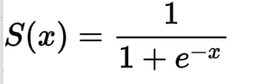
Activation Function : It decides whether the neuron should be activated or not.
relu : Rectified linear unit is most widely used and preferred activation function right now which ranges from 0 to infinity, All the negative values are converted into zero.
f(x)=max(0,x)
sigmoid: The sigmoid function also called a logistic function. having a characteristic that can take any real value and map it to between 0 to 1
it decides which value to pass as output and what not to pass.

Slide 21
Convolutional Layer
Pooling Layer
The Kernel/filter size is 3x3 and the pool size is 2x2 for all the layers.
21

Slide 22
Convolved feature
(feature Map)
Image

Slide 23
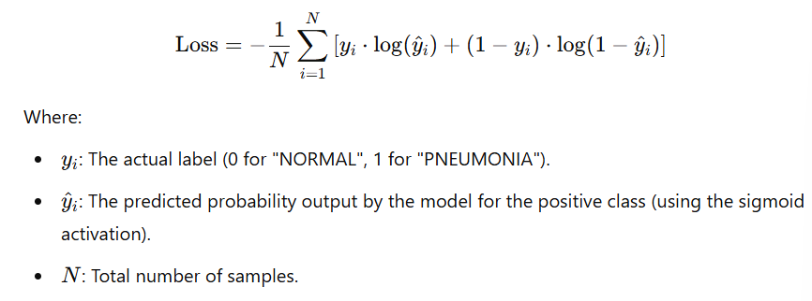
Model Compilation, Optimizer, and Loss Function
Optimizer: Adam
Dynamically adjusts learning rates for each parameter.
Enhances convergence speed and robustness.
Loss Function: Binary Cross-Entropy
Designed for binary classification tasks.
Perfect fit for distinguishing between normal and pneumonia images.
Performance Metric: Accuracy
Tracks the model's classification performance effectively.

Slide 24
Training the Model
Model Training: Trained on an augmented dataset for 12 epochs with early stopping to prevent overfitting and a learning rate reduction mechanism for finer weight updates during convergence.
Real-World Handling: Augmentation enhances the model's ability to adapt to variations in chest X-ray images.
Transfer Learning Option: Pre-trained CNNs like VGG16 can be leveraged for improved performance, especially for smaller datasets or limited resources.
Performance Evaluation: Metrics such as accuracy and loss are used to assess classification quality and prediction alignment with actual labels.

Slide 25
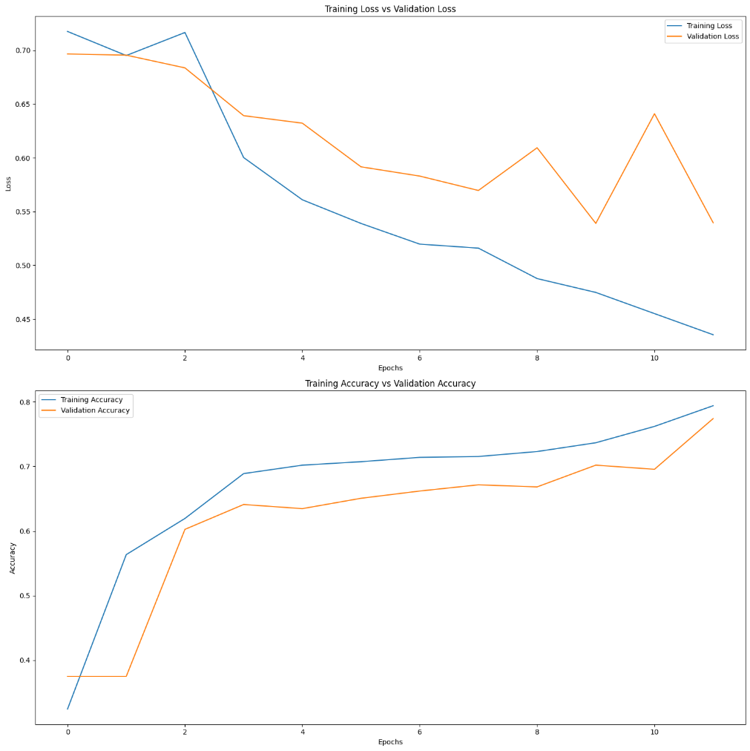
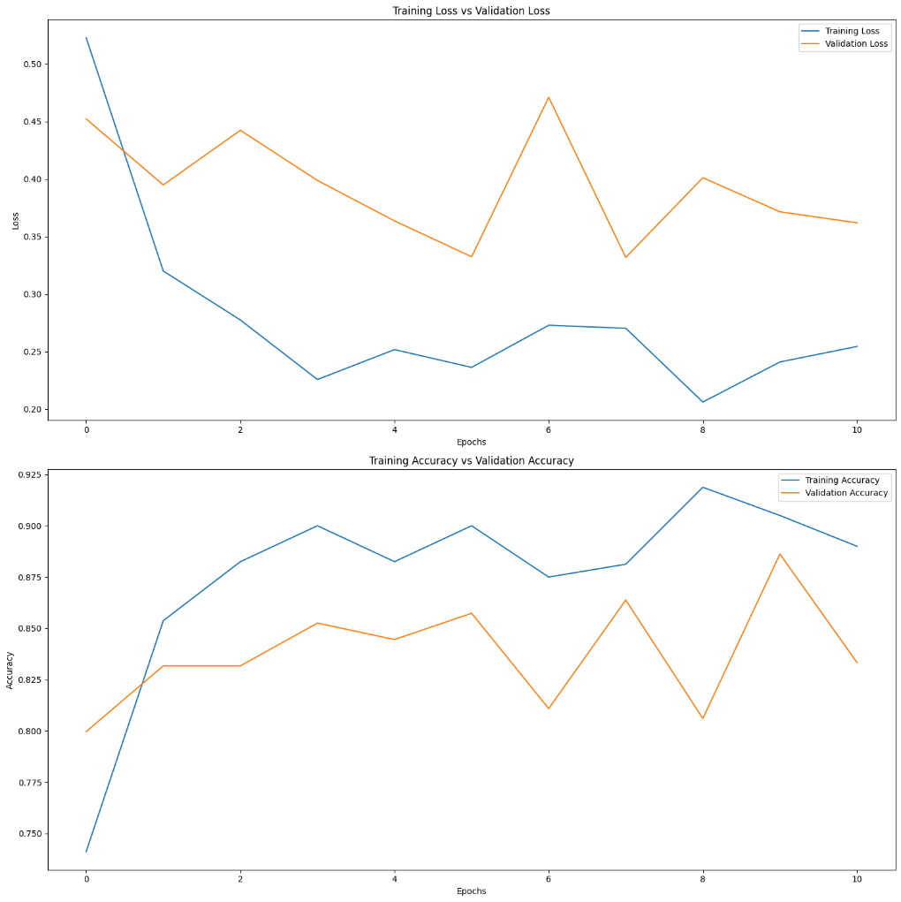
as

Slide 26
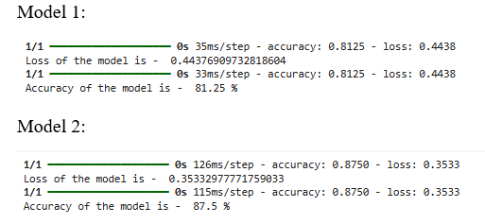
Result and Observation
The comparison between two models highlights the effectiveness of the implemented approaches in automating pneumonia diagnosis from chest X-ray images. Model 1 achieved an accuracy of 81.25% with a loss value of 0.4438, reflecting a reasonable alignment between predictions and actual labels. However, Model 2 outperformed it significantly, attaining a higher accuracy of 87.5% and a lower loss value of 0.3533, demonstrating more robust learning and improved performance. The preprocessing steps, including resizing, normalization, Gaussian blur, and data augmentation, were pivotal in enhancing the generalization capabilities of both models. Observations of consistent improvements in training and validation metrics in Model 2, along with better loss stabilization, suggest that it successfully addresses overfitting and variability. Overall, while both models effectively distinguish between normal and pneumonia chest X-rays, Model 2 provides a more reliable and accurate solution, underscoring the importance of iterative optimization in deep learning pipelines.

Slide 27
Thank You

